Slide 1
DS3202: PARALLEL PROGRAMMING
MODULE – 2
Basics of OpenMP
6th SEM
B.Tech
DSE

Slide 2
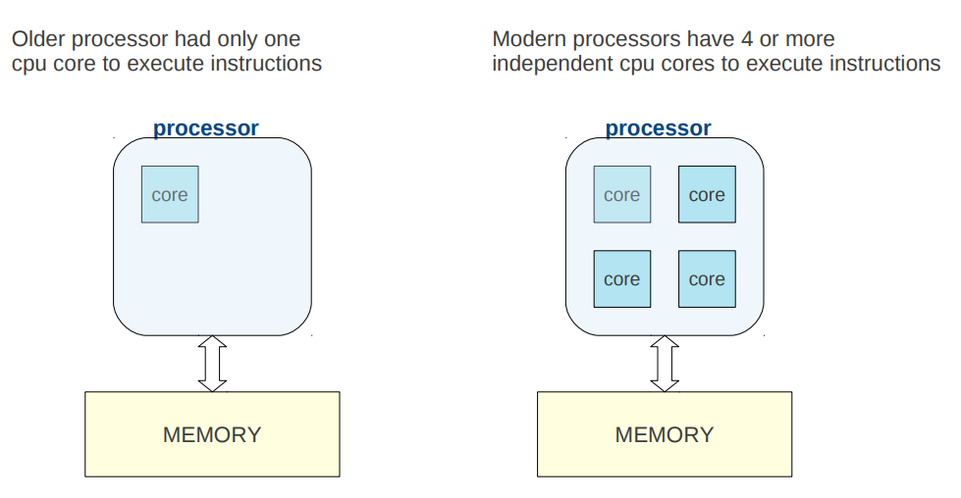
Basic Architecture

Slide 3
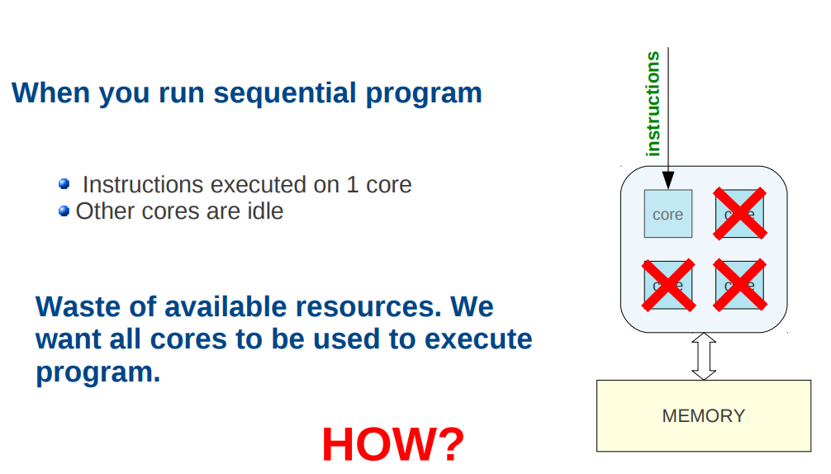
Sequential Programming

Slide 4
Introduction to OpenMP
OpenMP (Open Multi-Processing) is an application programming interface (API) designed for parallel and multi-threaded programming.
Open stands for open source
It provides a set of directives and functions that allow developers to write parallel code.
OpenMP is particularly well-suited for shared-memory parallel programming on multi-core processors.
In 1991, Parallel Computing Forum (PCF) group invented a set of directives for specifying loop parallelism in Fortran programs.
In 1997, the first version of OpenMP for Fortran was defined by OpenMP Architecture Review Board.
Binding for C/C++ was introduced later.

Slide 5
API components:
– Compiler directives
– Runtime library routines
– Environment variables
• Portability
– API is specified for C/C++ and Fortran
– Implementations on almost all platforms including Unix/Linux
and Windows
OpenMp Architecture is given in the next slide

Slide 6
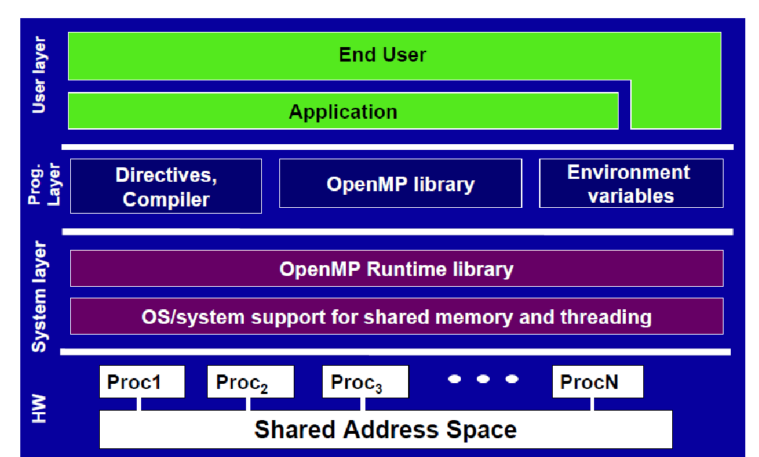

Slide 7
Overview of OpenMP
OpenMP API consists of :
Compiler Directives
Runtime Subroutines/Functions
Environment Variables

Slide 8
OpenMP - Compiler Directives
Compiler directive is a statement that causes the compiler to take a specific action during compilation
OpenMP compiler directives begin with #pragma omp in C/C++ .
“Pragma”: stands for pragmatic information.
A pragma is a way to communicate the information to the compiler.
A directive consists of a directive name followed by clauses
Example: #pragma omp parallel default (shared) private (var1,var2)
Other directives include sections, single, atomic, flush,etc

Slide 9
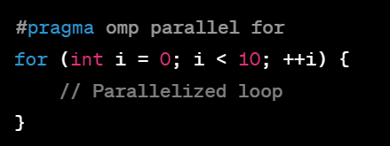
The #pragma omp parallel directive explicitly instructs the compiler to parallelize the chosen block of code (or) guide the compiler to generate parallelized code.
They define parallel regions, specify work-sharing constructs, and control data scope within parallel regions.

Slide 10
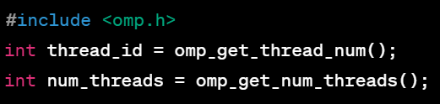
OpenMP - Runtime Subroutines/Functions
.
The OpenMP functions/subroutines are included in a header file called omp.h
Runtime functions are used to query information about the current thread, the number of threads, control parallel regions dynamically, and perform other runtime operations.
These functions are included in the OpenMP runtime library.

Slide 11

OpenMP - Environment Variables
Environment variables are settings that influence the behavior of OpenMP programs at runtime.
These variables can be set externally, affecting the execution of parallelized code without modifying the source.
Environment variables, such as OMP_NUM_THREADS, control the number of threads used in parallel regions, adjust thread affinity, and configure other aspects of the runtime environment.

Slide 12
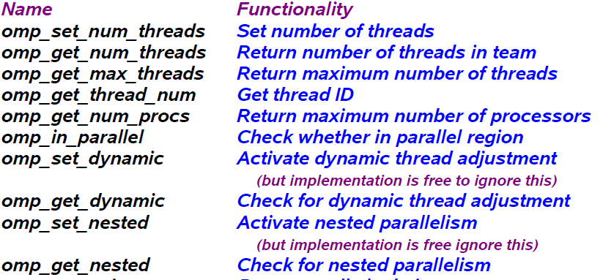
More Environment Variables

Slide 13
OpenMP Programming Model
Shared memory, thread-based parallelism
– OpenMP is based on the existence of multiple threads in the shared memory programming paradigm.
– A shared memory process consists of multiple threads.
• Explicit Parallelism
– Programmer has full control over parallelization. OpenMP is not an automatic parallel programming model.
• Compiler directive based
– Most OpenMP parallelism is specified through the use of compiler directives which are embedded in the source code.

Slide 14
OpenMP Thread vs Core
Thread is independent sequence of execution of program code.
Thread is a block of code with one entry and one exit.
OpenMP threads are mapped onto physical cores.
Possible to map more than 1 thread on a core.
In practice best to have one-to-one mapping.

Slide 15
Each process starts with one main thread. This thread is called master thread in OpenMP.
For a particular block of code, we create multiple threads along with this master thread. These extra threads other than master thread are called as slave threads.
OpenMP is called as Shared Memory model as OpenMP is used to create multiple threads and these multiple threads share the memory of main process.
OpenMP is called as Fork-Join model. It is because, all slave threads after execution get joined to the master thread.
i.e. Process starts with single master thread which executes sequentially until a parallel region is encountered and ends with single master thread.
When parallel region is encountered, it creates a team of parallel threads (FORK). When the team threads complete the parallel region, they synchronize and terminate, leaving only the master thread that executes sequentially (JOIN).

Slide 16
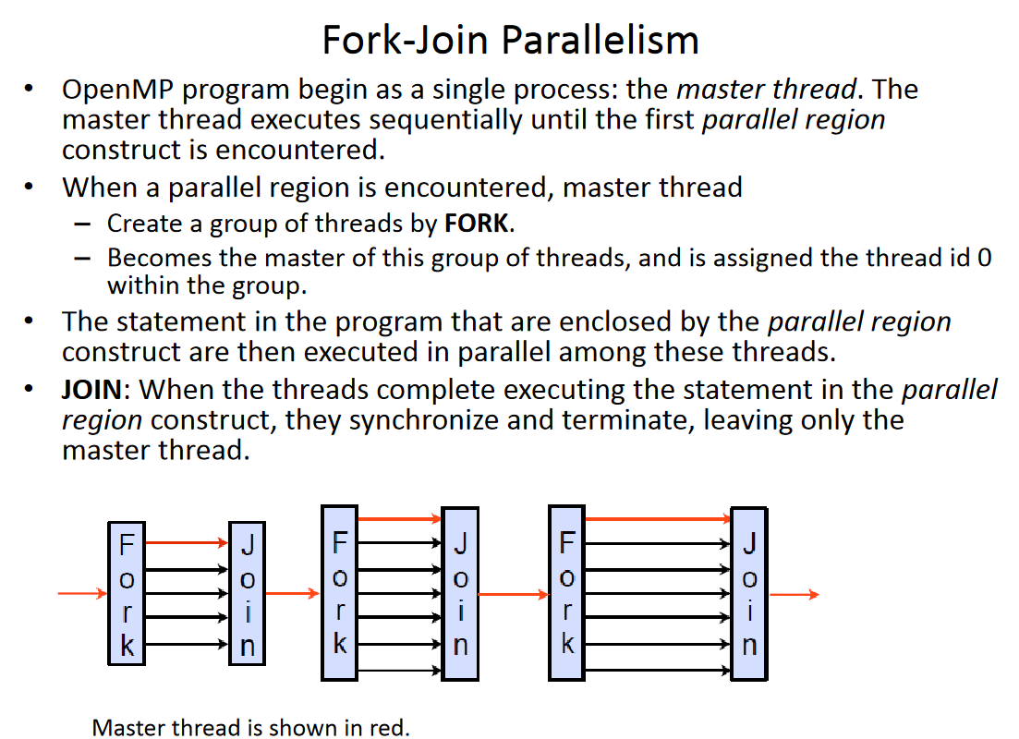

Slide 17
Creating Threads
We create threads in OpenMP with the parallel construct.
A simple example to create threads: #pragma omp parallel { printf("Hello World"); }
Suppose we are adding this code in a C language program.
This snippet will create multiple threads.
All of which are printing "Hello World".
By default, number of threads created is equal to number of Processor cores.

Slide 18
How to create required number of threads? #pragma omp parallel num_threads(7) { printf("Hello World"); }
If you want create specific number of threads, use num_threads() and a number indicating number of threads to be created should be passed as argument to num_threads().
In above example, seven threads will be created.
Each one will be responsible for printing "Hello World".

Slide 19
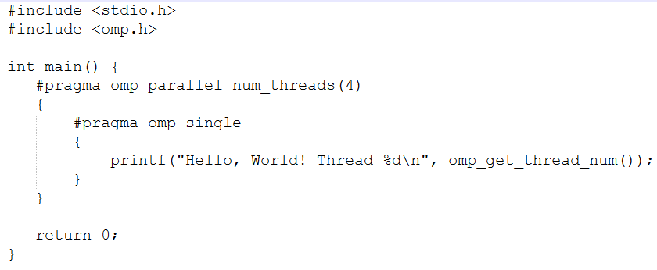
Hello World 4 times
The num_threads(4) clause in the #pragma omp parallel directive specifies that only 4 threads are created.
The #pragma omp single directive ensures that the enclosed block of code is executed by only one thread.

Slide 20
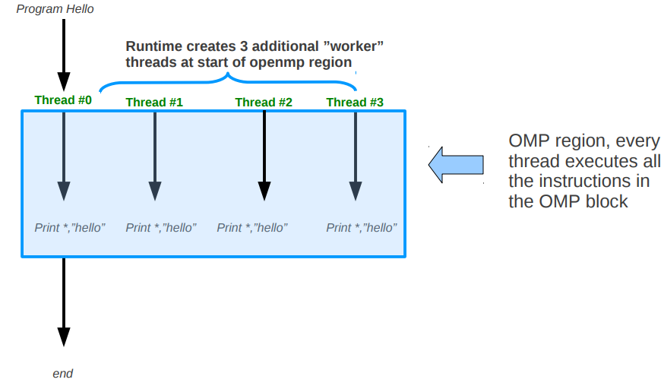
What happens at run time

Slide 21
How to create multiple threads using "for" loop? We can create multiple threads for "for" block. Check following snippet: #pragma omp parallel for for(i=0;i<6;i++) { printf("Hello World"); }
In above code snippet, since we are not mentioning number of threads, number of threads will be equal to number of cores.
This "for" loop will have six iterations which are done by these many number of threads.

Slide 22
How to allocate different work to different thread? In OpenMP, we can allocate different work to different thread by using "sections".
#pragma omp parallel sections num_threads(3) { #pragma omp section { printf("Hello World One"); } #pragma omp section { printf("Hello World Two"); } #pragma omp section { printf("Hello World Three"); } }
In above example, we have created three threads by mentioning num_threads(3). First thread will print "Hello World One". Second thread will print "Hello World Two" and third thread will print "Hello World Three".

Slide 23
Thread Synchronization
Synchronization is used to impose order constraints and to protect access to shared data
A synchronisation allows you get control on thread execution.
High level synchronization:
critical
atomic
barrier
ordered
master
single
Low level synchronization
– flush
– locks (both simple and nested)

Slide 24
High Level Synchronization
1. Barrier
OMP barrier is a very important concept in synchronization
Sometimes you may need all threads to wait at a certain point of your code before moving on.
Barrier provides a synchronization point at which threads in a parallel region will wait until all other threads in that section reach the same point.
For example, if you build up a data structure in parallel and then you want to perform some operations on said data structure, you need to ensure all of the threads have finished the first stage before the second can begin.
To do this, enter a barrier into your code as follows:
#pragma omp barrier

Slide 25
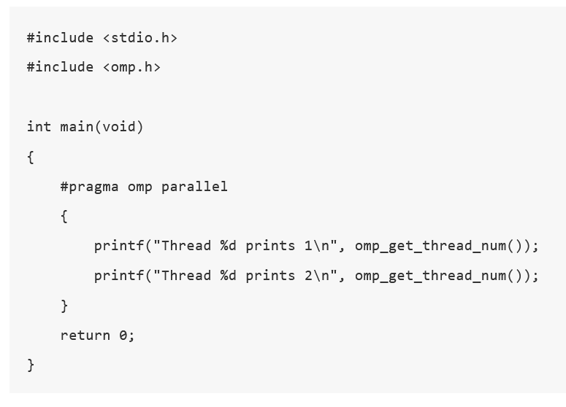

Slide 26
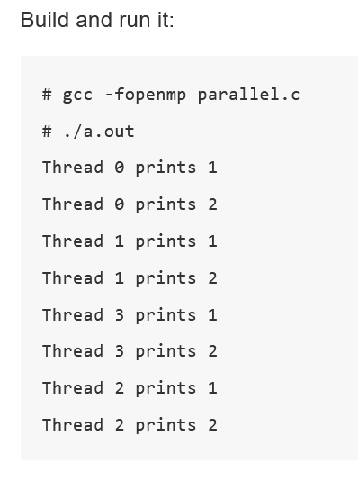

Slide 27
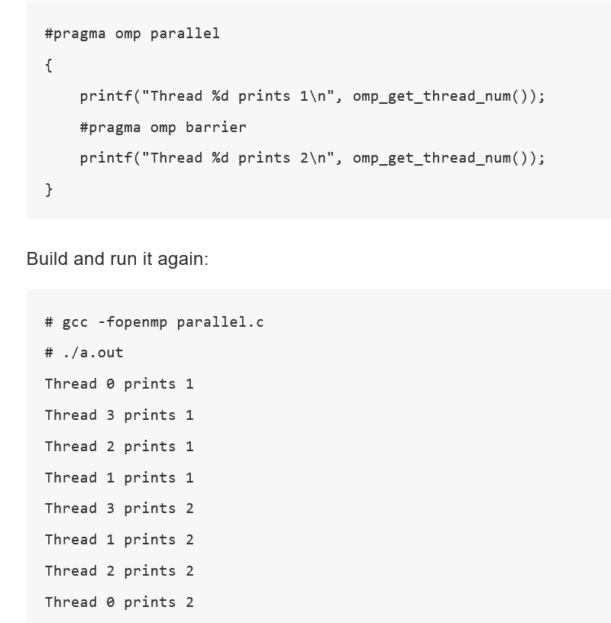

Slide 28
There are two kinds of barrier synchronisations in openmp:
Explicit
Implicit.
Explicit synchronisation is done with a specific openmp construct or directive clause that allows to create a barrier:
#pragma omp barrier .
Implicit synchronisation is done in two situations:
At the end of a parallel region
Eg: #pragma omp parallel{}
At the end of some openmp constructs
Eg: #pragma omp for
#pragma omp sections
If the user do not need implicit barriers, he can specify “nowait” clause at the end of the work-sharing pragma directive

Slide 29
Nowait Clause
Overrides any implied barrier at the end of a loop construct in a region.
That is using nowait clause can "break" the implicit barrier.
#pragma omp for nowait

Slide 30
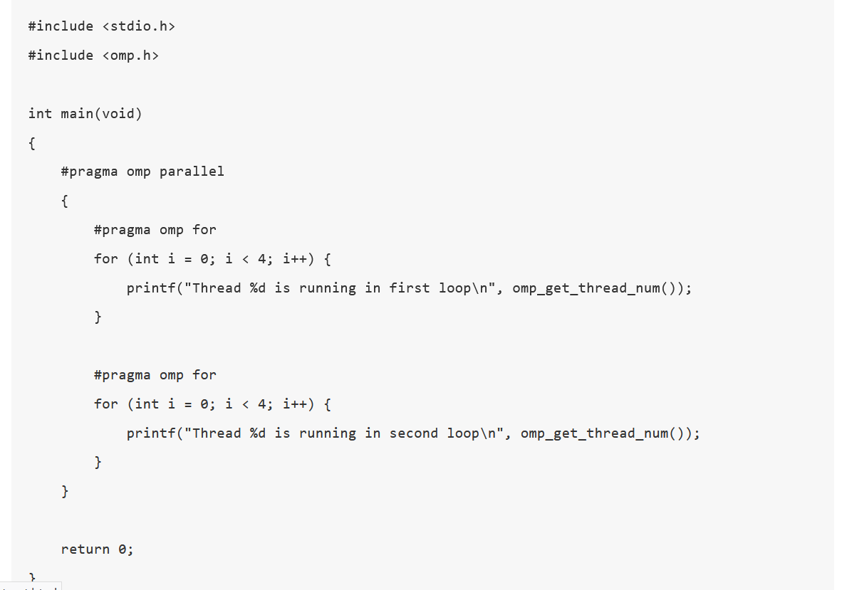
Example without nowait clause

Slide 31
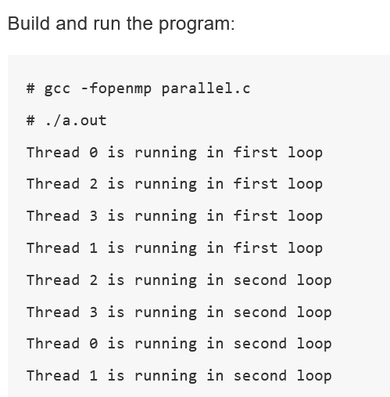
Because of the implicit barrier in "pragma omp for" region, the second "for-loop" won't run until the threads in first "for-loop" all finish.

Slide 32
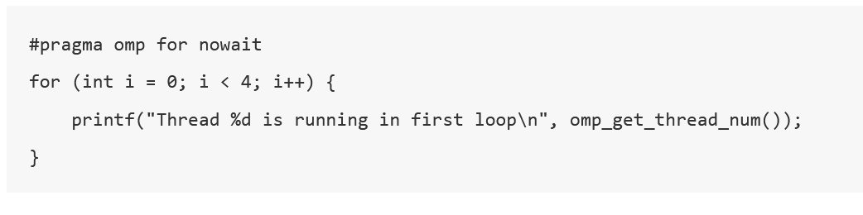
Now add nowait clause in first "for-loop" construct:

Slide 33
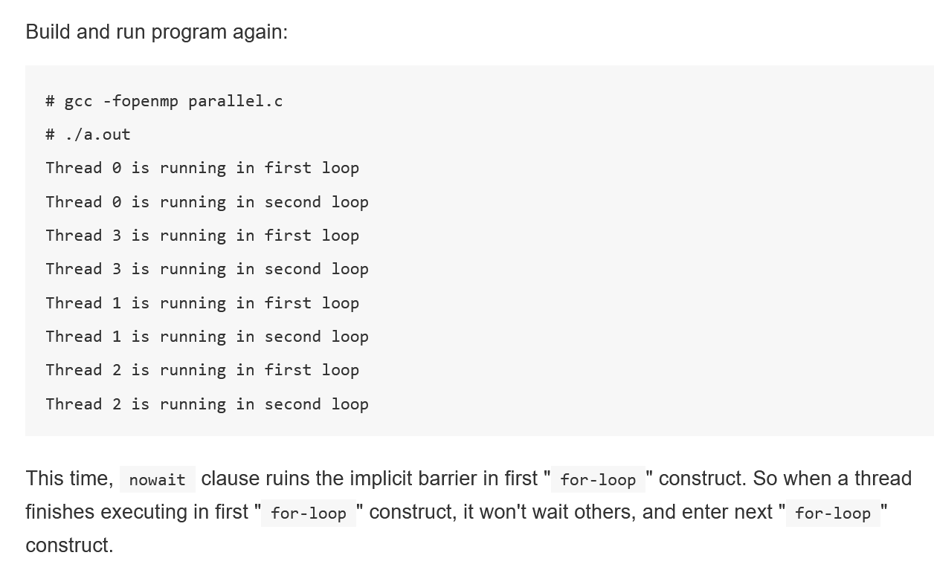

Slide 34
2. Atomic & Critical
Within a parallel region you may want to execute some code that only one thread should do at a time (eg. updating a shared variable). In these cases, you should use an atomic or critical region. It ensures that only one thread is able to enter a critical region at a time.
These define blocks of code within a parallel region that will only be executed by one thread at a time.
It is important to note that all threads will eventually run the code within the atomic/critical block.
You should use an atomic block if you are executing a simple statement within the block. Atomic operation has much lower overhead.
A critical region is used for lengthier blocks of code. It has high overhead.

Slide 35
Example
#pragma omp parallel shared(x)
{
. . .
#pragma omp atomic
{
x++;
}
. . .
#pragma omp critical
{
lengthier code involving variable x
}
}

Slide 36
3. Ordered
The ordered region executes in the sequential order
Parallel threads execute concurrently until they encounter the order block, which is then executed sequentially in the same order as it would get executed in a serial loop.
All threads need to wait for the lowest iteration possible.
The ordered clause is used when the sequence of iteration matters, and specific actions within the loop should happen in order.
It can be used to prevent race conditions where the order of execution affects the result.

Slide 37
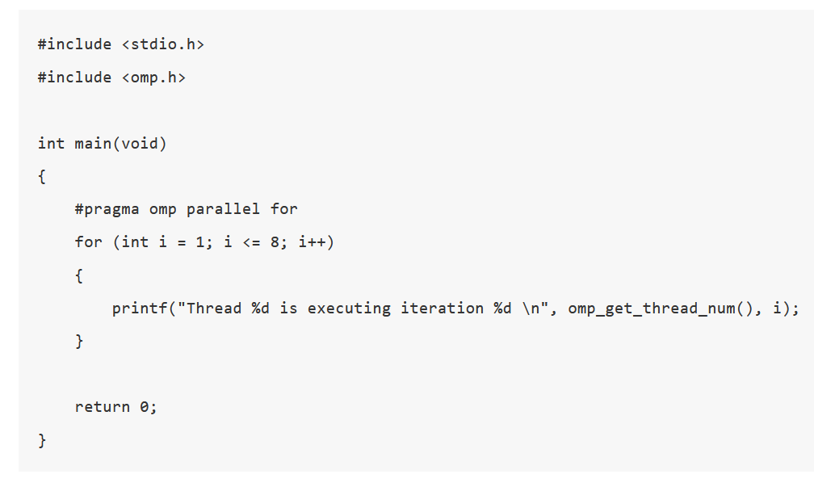

Slide 38
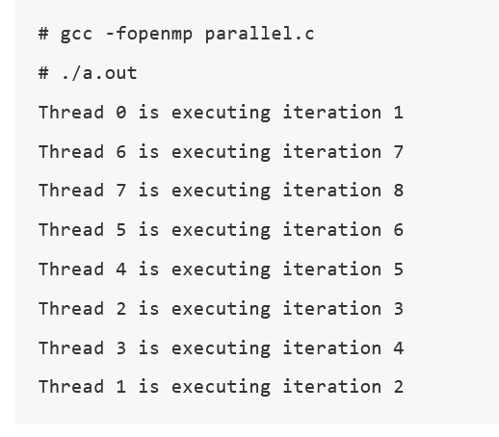

Slide 39
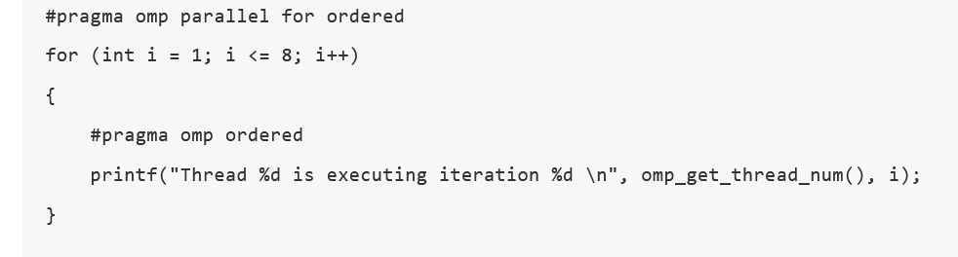

Slide 40
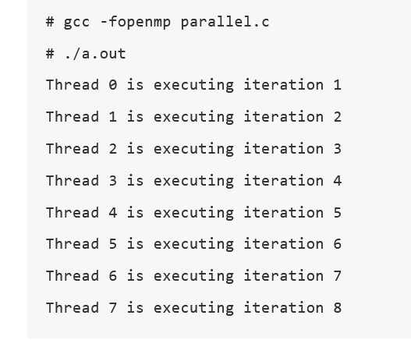

Slide 41
Example Explanation
In this example:
The #pragma omp parallel for ordered directive tells OpenMP to parallelize the loop and handle the ordering of loop iterations.
The #pragma omp ordered directive ensures that the code inside the block is executed in the exact order of the loop iterations, i.e., first iteration 0, then 1, and so on.

Slide 42
4. Master & Single Sections
Within a parallel region it is also possible that you have a block of code that should only be executed once.
You can do this with a single block (#pragma omp single), which means that the following block of code will only be executed once by the first thread to reach it (can be other than master thread)
or a master block (#pragma omp master) does the same but chooses the master thread only., which means it will only be executed by the master thread (thread ID 0).

Slide 43
Low Level Synchronization
Flush
Flush operation does not actually synchronize different threads.
It just ensures that a thread’s values are made consistent with main memory.
Flush forces data to updated in memory so other threads see the most recent value.
Locks
Locks can be used to protect resources.
A lock implies a memory fence (a “flush”) of all thread variables.

Slide 44
Performance Analysis
For parallel programs, performance is the primary concern.
The relative ease of using OpenMP is a mixed blessing.
In this section, we briefly introduce some factors that affect performance when programming, and some “best practices” to improve performance.

Slide 45
Performance Considerations
Factors Impacting (Affecting)Performance
Performance of the serial regions
Proportion of the serial parts and the parallel parts.
Overhead of thread management
Memory access

Slide 46
Factors Impacting (Affecting)Performance
The OpenMP program includes serial regions and parallel regions,
Firstly, the performance of the serial regions will affect the performance of the whole program. [Optimazation needed]
There are many optimization methods for serial programs, such as eliminating data dependencies, constant folding, copy propagation, removing dead code, etc.
Although the compiler has made some optimization efforts for serial programs, in fact, for current compilers the effect of this optimization is minimal.
A simpler and more effective method is to parallelize and vectorize the parts that can be parallelized or vectorized.

Slide 47
The second factor is the proportion of the serial parts and the parallel parts.
It is well understood that the more parts that can be parallelized in a program, the greater the room for program performance improvement.
Amdahl’s law gives the theoretical speedup in latency of the execution of a task at a fixed workload that can be expected of a system whose resources are improved.
This formula is often applied to parallel processing systems.

Slide 48
The third is the overhead of thread management.
Thread management usually includes creating, resuming, managing, suspending, destroying and synchronizing. The management overhead of threads is often large compared to computation, especially synchronization.
Critical sections and atomic sections serialize the execution and eliminate the concurrent execution of threads.
If used unwisely, OpenMP code can be worse than serial code because of all the thread overhead.

Slide 49
The fourth aspect is memory access
Usually, memory is the main limiting factor in the performance of shared memory programs.
Problems such as memory access conflicts will seriously affect the performance of the program.
The access location of data is the key to the latency and bandwidth of memory access.
The most commonly used method is to optimize data locality.

Slide 50
Ideas for Improving the performance
Based on the factors which affect the performance, there are several performance-enhancing efforts that can be considered:
Thread load balancing
Minimizing synchronization.
Using more efficient directives. For example, using PARALLEL DO/FOR instead of worksharing DO/FOR directives in parallel regions.
Expansion or merging of parallel regions
Improving cache hit rate
Optimization of round-robin scheduling
Variable property optimization
Optimization to reduce false sharing problem

Slide 51
OPENMP LANGUAGE FEATURES

Slide 52
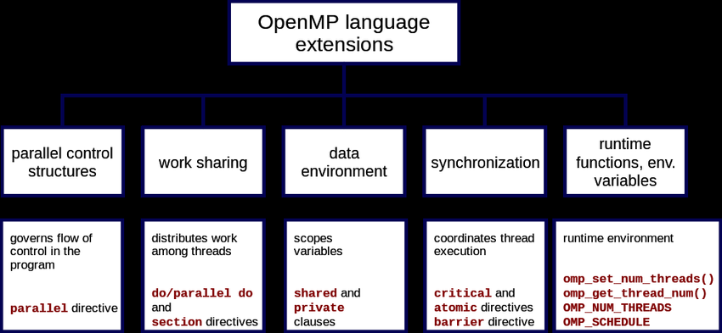
OpenMP Language Constructs

Slide 53
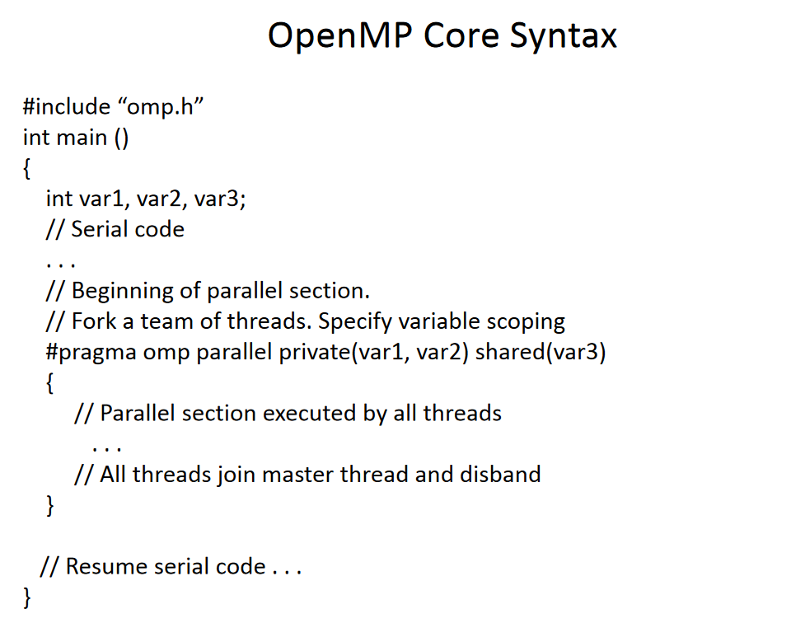

Slide 54
OpenMP Core Syntax
#include <stdio.h>
#include <omp.h>
int main() {
// Declare variables
int var1, var2, var3;
// Serial section
printf("Executing serial code...\n");
// Start of parallel section
#pragma omp parallel private(var1, var2) shared(var3) {
// Parallel execution by multiple threads
int thread_id = omp_get_thread_num();
printf("Thread %d is executing the parallel region.\n", thread_id);
// Parallel computation can be added here }
// Back to serial execution
printf("Resuming serial code...\n");
return 0; }

Slide 55
Parallel Construct
A directive that creates a parallel region in the code.
The parallel region is executed by a team of threads, and the work inside the region is divided among them.
Working
When a thread encounters a parallel construct, a team of threads is created to execute the parallel region
The thread that encountered the parallel construct becomes the master thread of the new team, with a thread number of zero for the duration of the new parallel region.
All threads in the new team, including the master thread, execute the region.
Once the team is created, the number of threads in the team remains constant for the duration of that parallel region.

Slide 56
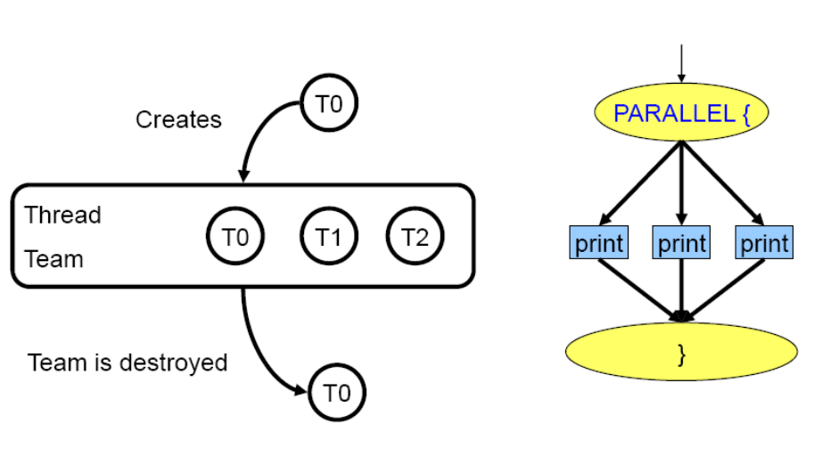
Parallel Region Construct

Slide 57
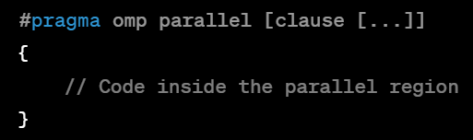
Syntax of Parallel Construct
#pragma omp parallel: This is the directive that indicates the start of a parallel region. It tells the compiler to create a team of threads to execute the enclosed block of code in parallel.
[clause [...]] : Optional clauses that can specify additional information such as the number of threads to use (num_threads clause) or the private variables (private clause).

Slide 58
OpenMP clauses
OpenMP clauses are speciﬁed as part of a directive-speciﬁcation.
Clauses are optional and, thus, may be omitted from a directive-speciﬁcation unless otherwise speciﬁed.
The order in which clauses appear on directives is not signiﬁcant unless otherwise speciﬁed.

Slide 59
Typical Clauses in OpenMP (Examples)
copyin
copyprivate
default
firstprivate
if (OpenMP)
lastprivate
nowait
num_threads
ordered
private
reduction
schedule
shared

Slide 60
Example of Parallel Construct
The #pragma omp parallel directive creates a parallel region.
The omp_get_thread_num() function is used to obtain the thread ID, and each thread prints a message with its ID.

Slide 61
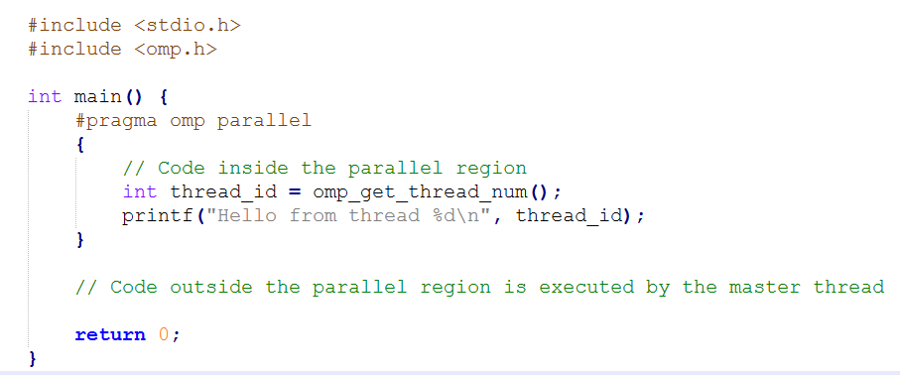


Slide 62
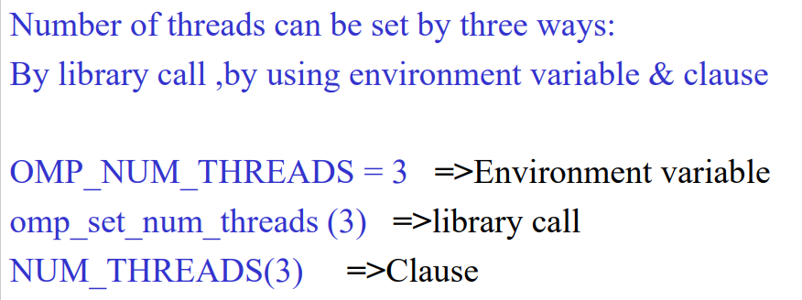
Setting Threads

Slide 63
Examples (3 ways)
omp_set_num_threads( num );
#pragma omp parallel num_threads(7) { printf("Hello World"); }

Slide 64
Work Sharing Construct
Used to assign independent work to threads.
Facilitates the parallelization of loops and other regions of code, where each thread takes responsibility for a specific subset of the iterations or workload.
Work-sharing constructs help exploit parallelism in loops, sections, and other parts of the code, distributing the workload among the available threads to improve overall performance.
Organization of work sharing :
for or do: concurrent loop iterations.
sections: concurrent tasks.
single: block of code for single directive is executed by only one thread, a barrier is implied in the end.

Slide 65
Features of work sharing constructs
Work-sharing constructs do not create new threads.
Work-sharing construct must be enclosed dynamically within a parallel region.
A work-sharing construct distributes the execution of the corresponding region among the members of the team that encounters it.
Work-sharing constructs must be encountered by all members of a team or none at all.
A work-sharing region has no barrier on entry; however, an implied barrier exists at the end of the work-sharing region, unless a no wait clause is specified.
If a no wait clause is present, an implementation may omit the barrier at the end of the work-sharing region.
In this case, threads that finish early may proceed straight to the instructions that follow the work-sharing region without waiting for the other members of the team to finish the work-sharing region.

Slide 66
“For” directive in work sharing construct
#pragma omp parallel directive creates a team of threads, and within that parallel region.
#pragma omp for directive will partition parallel iterations across threads.
Do is the analogous directive in Fortran.
The actual number of threads and the order in which they print the messages varies depending on the system.

Slide 67
Example 1
#include <omp.h>
#include <stdio.h>
int main() {
// Parallel region
#pragma omp parallel {
// Parallelized for loop
#pragma omp for
for (int i = 0; i < 10; i++) {
int thread_id = omp_get_thread_num(); // Get thread ID
printf("Iteration %d executed by Thread %d\n", i, thread_id);
} }
return 0; }

Slide 68
Output
Iteration 0 executed by Thread 0
Iteration 1 executed by Thread 1
Iteration 2 executed by Thread 2
Iteration 3 executed by Thread 3
Iteration 4 executed by Thread 0
Iteration 5 executed by Thread 1
Iteration 6 executed by Thread 2
Iteration 7 executed by Thread 3
Iteration 8 executed by Thread 0
Iteration 9 executed by Thread 1

Slide 69
Example 2 of “for” directive
#include <stdlib.h>
#include <stdio.h>
#include <omp.h>
int main() {
int nthreads, tid;
omp_set_num_threads(3);
#pragma omp parallel private(tid)
{
int i;
tid = omp_get_thread_num();
printf("Hello world from (%d)\n", tid);
#pragma omp for
for (i = 0; i <= 4; i++) {
printf("Iteration %d by %d\n", i, tid);
}
} // all threads join master thread and terminate
return 0; }

Slide 70
Output
Hello world from (0)
Hello world from (1)
Hello world from (2)
Iteration 0 by 0
Iteration 1 by 0
Iteration 2 by 1
Iteration 3 by 1
Iteration 4 by 2

Slide 71
Explanation of “for” directive
Hello World Messages:
Each thread prints its "Hello world" message when it starts executing the parallel region.
Iteration Distribution:
OpenMP divides the loop iterations among the 3 threads. The exact distribution depends on the scheduling policy (default is static scheduling).
For example:
Thread 0 executes iterations 0 and 1.
Thread 1 executes iterations 2 and 3.
Thread 2 executes iteration 4.

Slide 72
“Section” directive in work sharing construct
Divides the code into sections, and each section is executed in parallel by a team of threads.
Each section can be considered a distinct unit of work.

Slide 73

Example of Section Directive
#include <stdio.h>
#include <omp.h>
int main() {
#pragma omp parallel sections
{
#pragma omp section
{
printf("Thread %d executes section 1\n", omp_get_thread_num());
}
#pragma omp section
{
printf("Thread %d executes section 2\n", omp_get_thread_num());
}
}
return 0; }

Slide 74
Output of Example – Section Directive
Two threads are created within the parallel region, and each thread executes one of the sections.
The omp_get_thread_num() function is used to retrieve the thread ID, and each thread prints a message indicating which section it is executing.
The output can vary because the order of section execution is not deterministic.

Slide 75
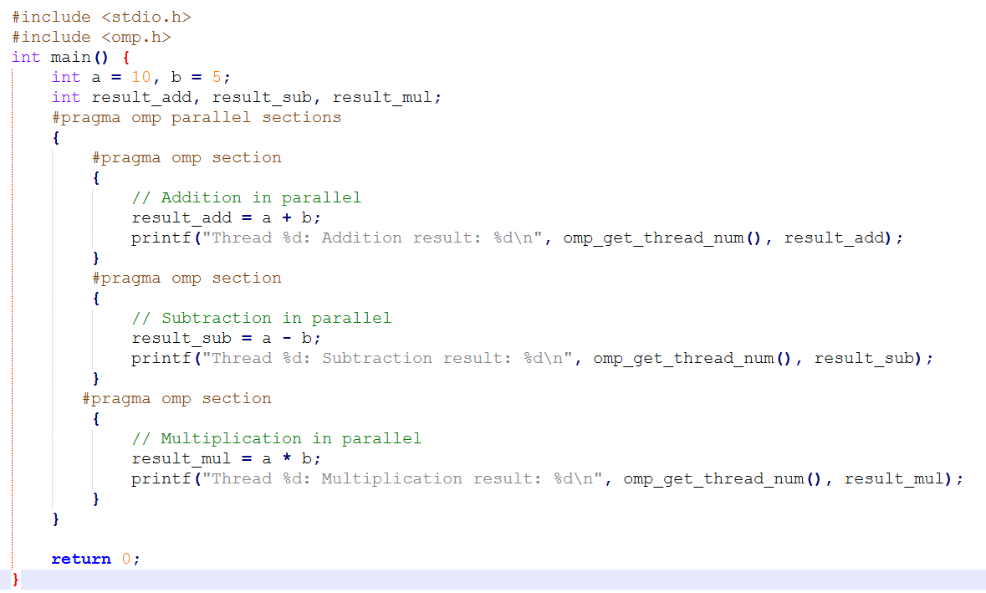
How to allocate different work to different threads which calculate addition, subtraction and multiplication of two numbers?

Slide 76
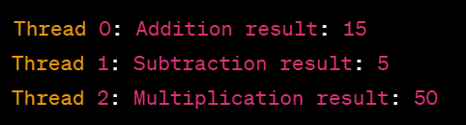
Output

Slide 77
Single directive in work sharing construct
Specifies a block of code that is executed by a single thread.
Used for tasks that should be performed by only one thread, such as initialization.

Slide 78
Example of Single Directive
#include <stdio.h>
#include <omp.h>
int main() {
#pragma omp parallel
{
// Code executed by all threads
#pragma omp single
{
// Code executed by a single thread
printf("Thread %d executes a single task\n", omp_get_thread_num());
}
}
return 0; }
Output:
Thread 2 executes a single task

Slide 79
Output of Example – Single Directive
In this output, the single thread (in this case, with ID 2) that encounters the single construct is the one executing the block of code within the single construct.
The other threads in the parallel region do not execute this particular block of code.

Slide 80
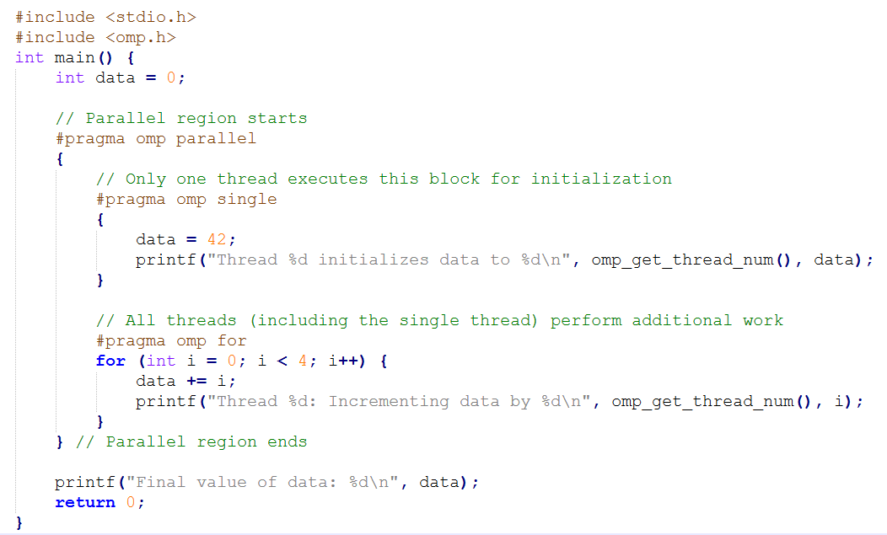
Single directive performs the task of initialization and additional tasks are done by other threads

Slide 81
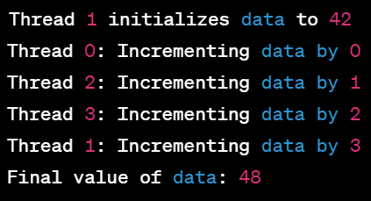
Output:

Slide 82
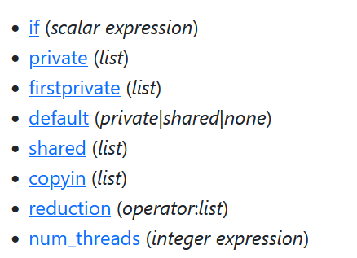
Parallel and Work-sharing Clauses
After an OpenMP sentinel, the parallel directive name can be followed by one or more clauses to modify the parallel construct.
The available clauses for the OpenMP parallel construct are:

Slide 83
If Clause
Specifies whether a loop should be executed in parallel or in serial.
The if clause, if present, helps to determine whether the parallel construct will be used.
There are two situations where the parallel construct would not be used:
if the scalar expression in this clause evaluates to false or
if the parallel construct appears while another parallel construct is active

Slide 84
Syntax:
if (scalar expression)
{
}
Only execute in parallel if expression evaluates to true
Otherwise, execute serially

Slide 85
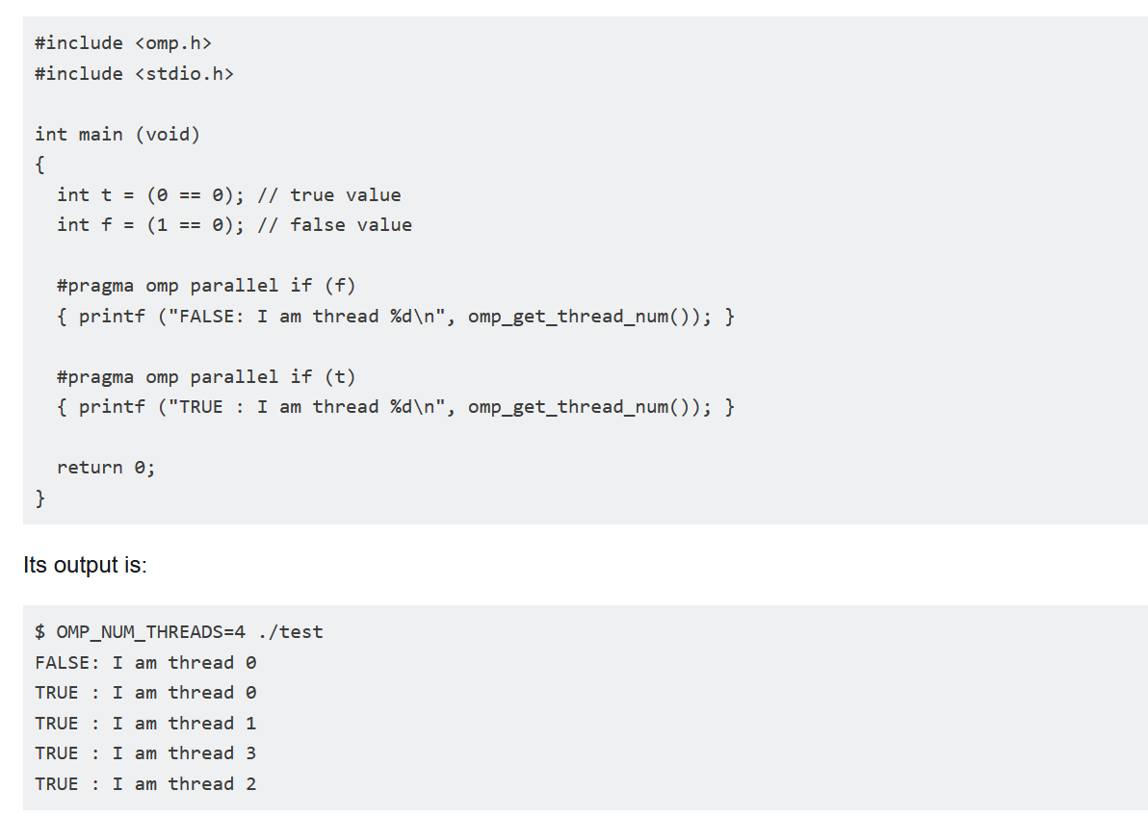

Slide 86
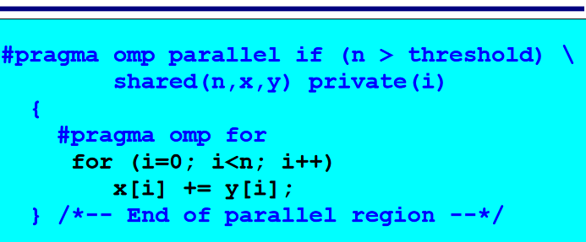

Slide 87
Num_threads Clause
The num_threads clause is one of the three ways to specify the number of threads to use when creating parallel regions.
The num_threads clause specifies, during execution, the number of threads to use when creating the parallel region from the directive it is part of.
Sets the number of threads in a thread team.
#pragma omp parallel num_threads(7) { printf("Hello World"); }

Slide 88
Data Scope Attribute Clause
OpenMP programs have two different basic types of memory: private and shared (or) in a parallel section variables can be private or shared:
SHARED : The data within a parallel region is shared, which means visible and accessible by all threads simultaneously. Any update command will modify data for all threads. By default, all variables in the work sharing region are shared except the loop iteration counter. Shared variables must be used with care because they cause race conditions.
PRIVATE : Specifies that each thread should have its own instance of a variable. Private variables are local to each thread, and each thread gets its own private copy of the specified variables. A private variable is not initialized, and the value is not maintained for use outside the parallel region. By default, the loop iteration counters in the OpenMP loop constructs are private.

Slide 89
Shared Clause
The shared clause can be used to list variables that are shared among all threads.
This isn't usually necessary because most variables are shared by default.
A shared variable has the same address in the execution context of every thread.
All threads have access to shared variables.

Slide 90
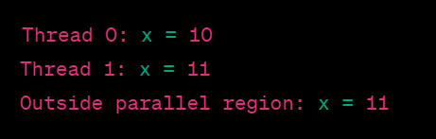
Example of SHARED Clause
#include <stdio.h>
#include <omp.h>
int main() {
int x = 10;
#pragma omp parallel shared(x)
{
// All threads share the same copy of x
x += omp_get_thread_num();
printf("Thread %d: x = %d\n", omp_get_thread_num(), x);
}
// x outside the parallel region is affected by the threads
printf("Outside parallel region: x = %d\n", x);
return 0; }

Slide 91
Output of SHARED code example
The variable x is declared outside the parallel region and is shared among all threads by default.
Inside the parallel region, each thread increments its own thread number to the shared variable x.
As a result, the value of x is modified by each thread, and the changes made by the threads are visible outside the parallel region as well since it is sharing the same address space.

Slide 92
Private Clause
Direct the compiler to make one or more variables private.
#pragma omp parallel private (var)
#pragma omp parallel private (var1, var2,.....)
The private clause is followed by a list of variables that will be instantiated separately for each thread in the parallel region.
The type of each private variable is determined by its type in the enclosing context, but its value is undefined at the beginning of the parallel region.
Certain global variables cannot be listed as private because their status can't be changed to undefined.
Each thread has its own private copy of variable, and modifications inside the parallel region do not affect the original variable outside the parallel region.
Use private clause can let every thread get its own copy of shared variable, but the initial value is still unspecified
The actual output may differ depending on the order in which threads execute.

Slide 93
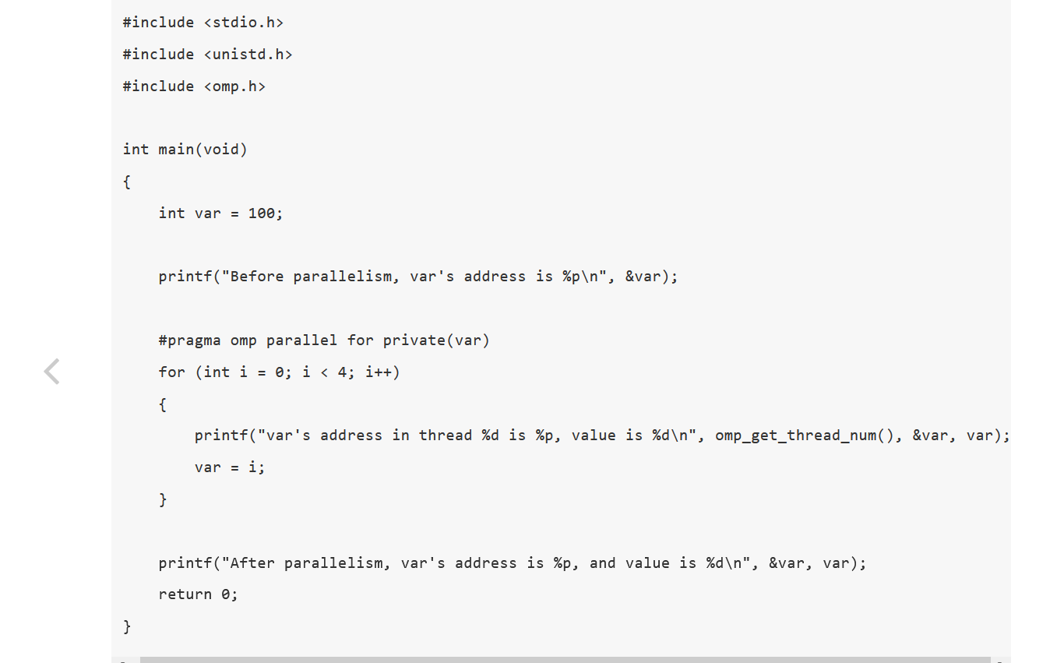
Example 1

Slide 94
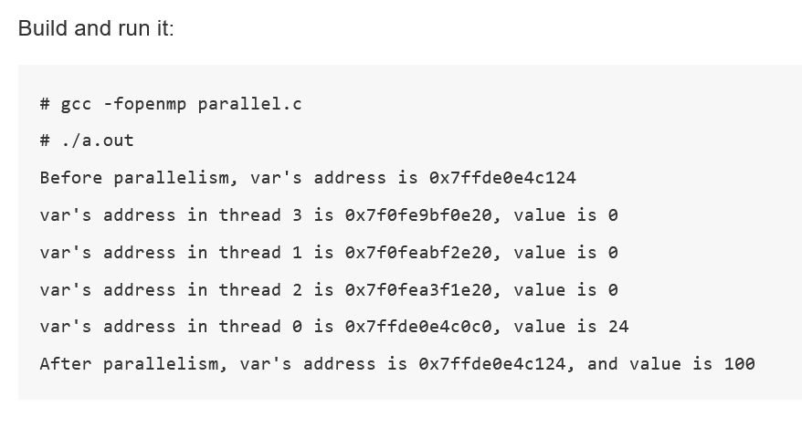

Slide 95
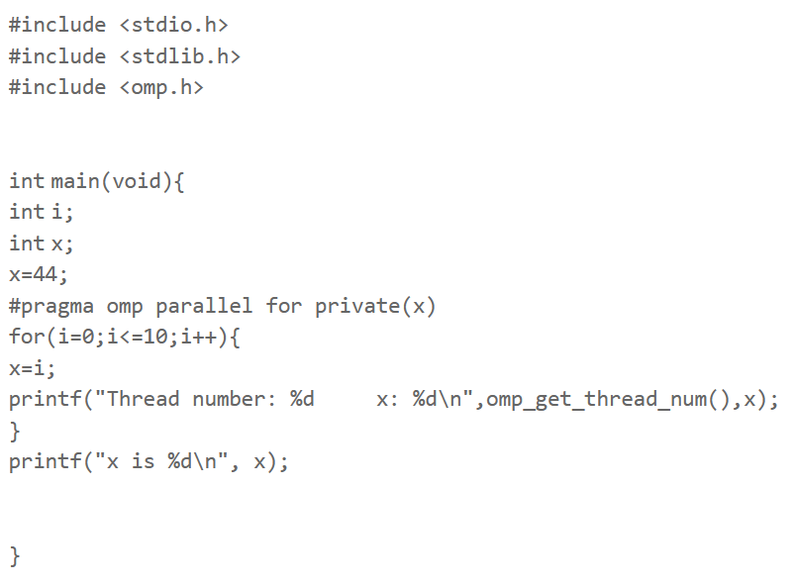
Example 2

Slide 96
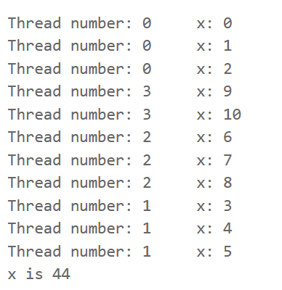

Slide 97
The two special cases of private clause are:
Firstprivate clause
Lastprivate clause

Slide 98
FIRSTPRIVATE Clause
Used to declare and initialize variables within a parallel region that should be private to each thread.
The firstprivate clause contains a list of variables that, like the private variables, are instantiated separately for each thread in the parallel region.
The one difference is that instead of being undefined at the beginning of the parallel region, the value of each variable is initialized to the value it had when the parallel region was entered. Ie, the firstprivate clause initializes the private copies of these variables with the values of the original variables before the parallel region.
The firstprivate clause is particularly useful when you want each thread to work with a private copy of a variable and initialize it with a specific value from the original variable before entering the parallel region.
If you specify just private(x), the value of x in parallel loop is not initialized. Thus, x will have random floating number. On the other hand, firstprivate(x) will allow x to have a specific value, which is declared before a parallel region.
Firstprivate ensures that each thread has a separate copy and changes made by threads are not reflected globally.

Slide 99
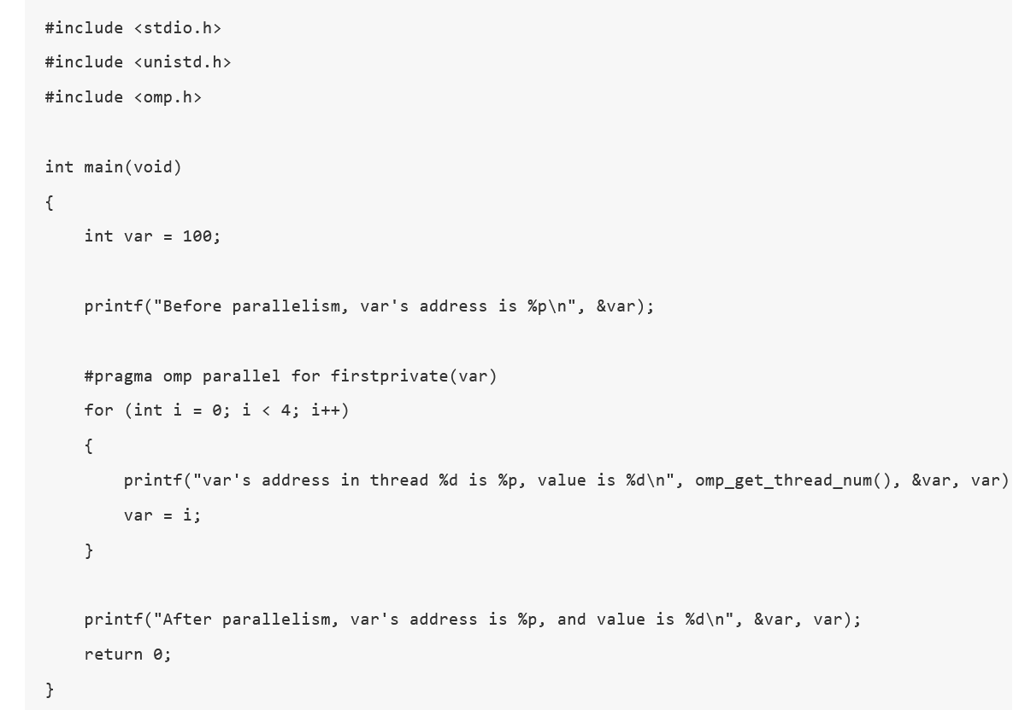
Example 1

Slide 100
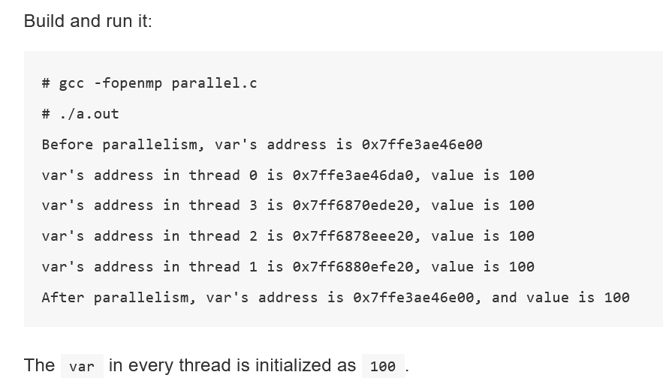

Slide 101
LASTPRIVATE Clause
It performs finalization of private variables.
The iteration that occurs last when the loop is executed sequentially.
For each thread, a private copy of the specified variable is created.
These private copies are used for computations within the parallel region.
After the loop is executed, the value of the variable from the last iteration is shared among all threads.
The shared value is the one that was produced by the thread executing the last iteration of the loop.
This clause is commonly used when the variable inside the loop represents an accumulation or result that needs to be shared among threads after the loop completes.
That is, lastprivate clause makes the value in last sequential iteration assigned back to the shared variable
The lastprivate clause in OpenMP is used to ensure that the last iteration’s value of a private variable is assigned back to the original variable after the parallel execution.

Slide 102
Suppose we wanted to keep the last value of x after the parallel region. This can be achieved with lastprivate. Replace private(x) with lastprivate(x) in the example 2 of private clause and this is the result.

Slide 103
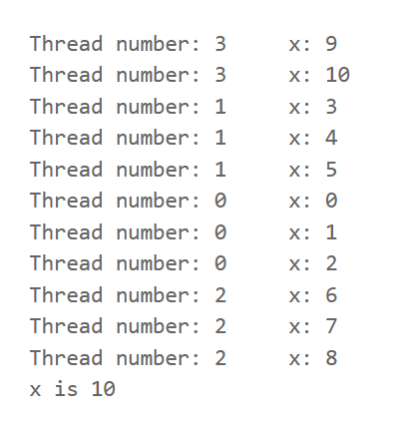
Output: (Notice that it is 10 and not 8. That is to say, it is the last iteration which is kept, not the last operation.)

Slide 104
REDUCTION CLAUSE
An operation that “combines” multiple elements to form a single result, such as a summation, is called a reduction operation.
A variable that accumulates this result is called a reduction variable.
A private copy for each list variable is created for each thread.
At the end of the loop, the reduction operation is applied to all private copies of the shared variable, and the final result is written to the global shared variable.
The reduction clause lists variables upon which a reduction operation will be done at the end of the parallel region.
The clause also specifies the operator for the reduction.
It performs a reduction on the variables subject to given operator.

Slide 105
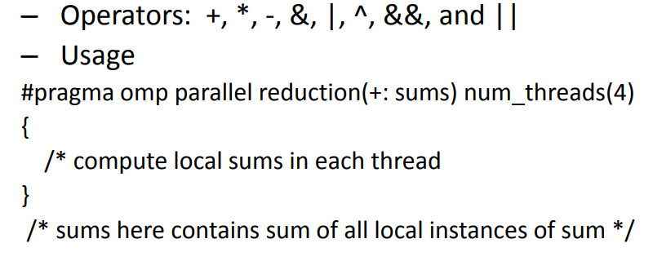
A private copy of each reduction variable is created for each thread and is initialized as described in the table in the next slide.
The private copies of the variables are updated as the threads execute and then the private copies from all threads are combined at the end of the parallel region.
The reduction operations and the corresponding initial values are given in the next slide.
Format
reduction(operator:list)

Slide 106
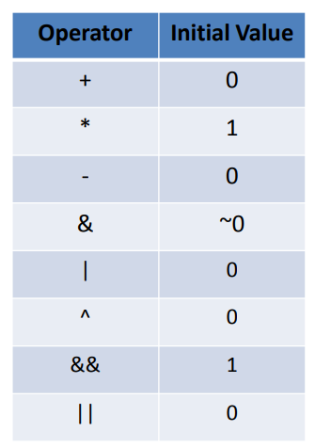
Reduction operator initial values

Slide 107
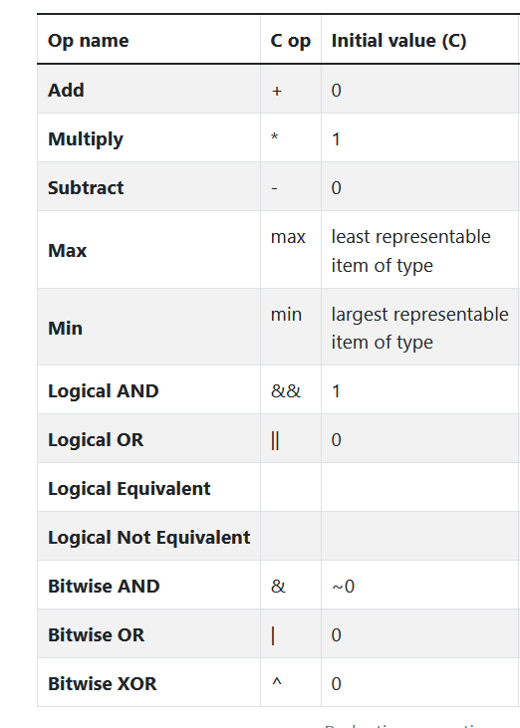
Reduction Operator Names

Slide 108
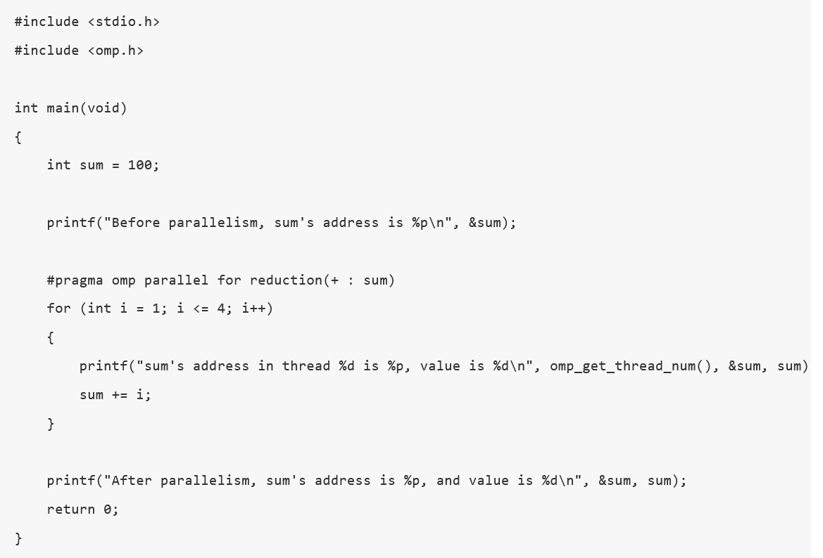
Example

Slide 109
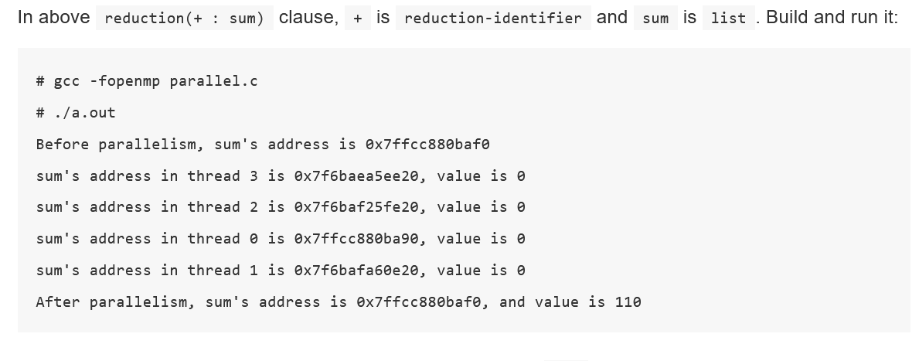

Slide 110
Output Explanation
From the output, we can see every thread gets a local copy of sum (different addresses), but it is initialized to 0 (this is according to the + operation), not an unspecified value.
After finishing this parallel region, the local sum of every thread are reduced to one value and combined to the original shared sum defined in main function (the value is 110).
The final sum (after reduction) is correctly computed as 100 + (1+2+3+4) = 110.

Slide 111
Sum of natural numbers without reduction clause
#include <stdio.h>
#include <omp.h>
int main()
{
int i,sum = 0;
int thread_sum[4];
omp_set_num_threads(4);
#pragma omp parallel
{
int ID=omp_get_thread_num();
thread_sum[ID]=0;
#pragma omp for
for(i=1;i<=100;i++)
{
thread_sum[ID]+=i; // Individual thread sum
}
}
for(i=0;i<4;i++)
sum+=thread_sum[i]; // Gathered thread sum
printf("Sum=%d",sum);
}

Slide 112
Code explanation
The code uses "for" construct to add 25 numbers in each of 4 threads and adds the partial sum.
This causes false sharing and gives incorrect result.

Slide 113
Same code with reduction clause
#include <stdio.h>
#include <omp.h>
void main()
{
int i,sum=0;
omp_set_num_threads(4);
#pragma omp parallel
{
#pragma omp for reduction(+:sum)
for(i=1;i<=100;i++)
sum+=i;
}
printf("Sum=%d\n",sum);
}

Slide 114
Code Explanation
The clause used in reduction(+:sum) where + is the operator and sum is reduction variable.
Reduction clause does the work of initiating and calculating individual thread sums to local variable and then combining these local variables into a single global variable.

Slide 115
Shorthand Assignment Operators
Reduction supports shorthand operations like +=, -=, *=, /= etc.
Operations like sum=sum+a[i] can be written as a shorthand operation.
It is similar for subtraction, multiplication, division and other operations.
Associativity of shorthand operator is always right to left.

Slide 116
Data Copying Clauses
There are two clauses:
The copyin clause (allowed on the parallel construct and combined parallel work-sharing constructs)
The copyprivate clause (allowed on the single construct).
These clauses support the copying of data values from private or threadprivate variables on one implicit task or thread to the corresponding variables on other implicit tasks or threads in the team.
The clauses accept a comma-separated list of list items.
All list items appearing in a clause must be visible, according to the scoping rules of the base language.
Clauses may be repeated as needed, but a list item that specifies a given variable may not appear in more than one clause on the same directive.

Slide 117
Before introducing these two clauses, we need to introduce a new data-sharing attribute, named threadprivate.
The difference between private variables and thread private variables can be briefly described as follows:
Private variables are local to a region and are placed on the stack most of the time. The lifetime of a private variable is the duration defined by the data scope clause. Every thread, including the main thread, makes a private copy of the original variable, and the new variable is no longer storage-associated to the original.
Threadprivate variables are persist across regions, most likely to be placed in the heap or in thread-local storage, which can be seen as being stored in a local memory local to the thread. The main thread uses the original variable and other threads make private copies of the original variable. The host variable is still store-associated with the original variable.

Slide 118
Copyin Clause
The copyin clause is the one of two data copying clauses that can be used on the parallel construct or combined parallel worksharing constructs.
The copyin clause causes the listed variables to be copied from the primary thread to all other threads in the team immediately after the threads have been created and before they do any other work.
The variables in the list must also be threadprivate because if they were shared, copying would be meaningless.
Specifies that the value of the master thread's threadprivate variable or list of threadprivate variables is copied to the threadprivate variable of the other threads in the parallel region.
Format
copyin(list) (or) copyin(var)

Slide 119
Copyprivate Clause
The copyprivate clause which is only allowed on the single construct.
Specifies that the value of a variable or list of variables acquired by one thread is shared with all other threads.
The typical usage is to have one thread read or initialize private data that is subsequently used by the other threads as well.
After the single construct has ended, but before the threads have left the associated barrier, the values of variables specified in the associated list are copied to the other threads.
Do not use copyprivate in combination with the nowait clause
The copyprivate clause provides a mechanism to use a private variable to broadcast a value from the data environment of one implicit task to the data environments of the other implicit tasks that belong to the parallel region.
To avoid data races, concurrent reads or updates of the list item must be synchronized with the update of the list item that occurs as a result of the copyprivate clause.
Format
copyprivate (list)

Slide 120
Default Clause
The default clause sets the sharing status of any variables whose sharing status is not explicitly determined.
The default clause determines the implicit data-sharing attribute of certain variables that are referenced in the construct
The private option is available only in Fortran.
The none option requires that every variable referenced in the parallel region have a sharing attribute.
Format
default (shared | none)
#pragma omp parallel default(none) shared(n,x) reduction(+: sum) num_threads(8)

Slide 121
Default clause specifies the scope of variables within the parallel region that are not explicity scoped by another clause. The following options are valid modes for this clause:
shared—Sets all variables in the parallel region whose sharing attributes are implicitly determined to shared. That is, in effect if the default clause is unspecified, means that any variable in a parallel region will be treated as if it were specified with the shared clause.
none—Requires each variable in the parallel region be scoped by an OpenMP clause. This means that any variables used in a parallel region that aren't scoped with the private, shared, reduction, firstprivate, or lastprivate clause will cause a compiler error.

Slide 122
End of Module 2
(THANK YOU)

